Slide 2
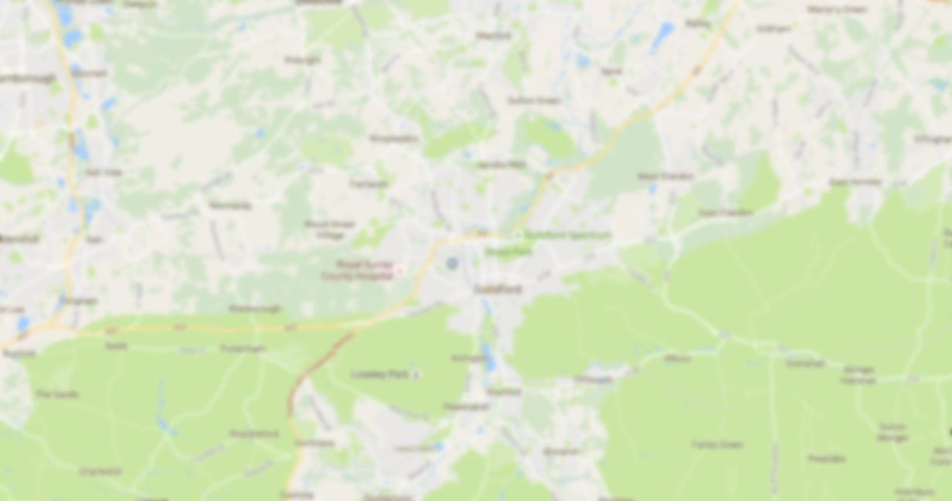
Where do Students live?
Student Data from 2011-2016

Slide 3
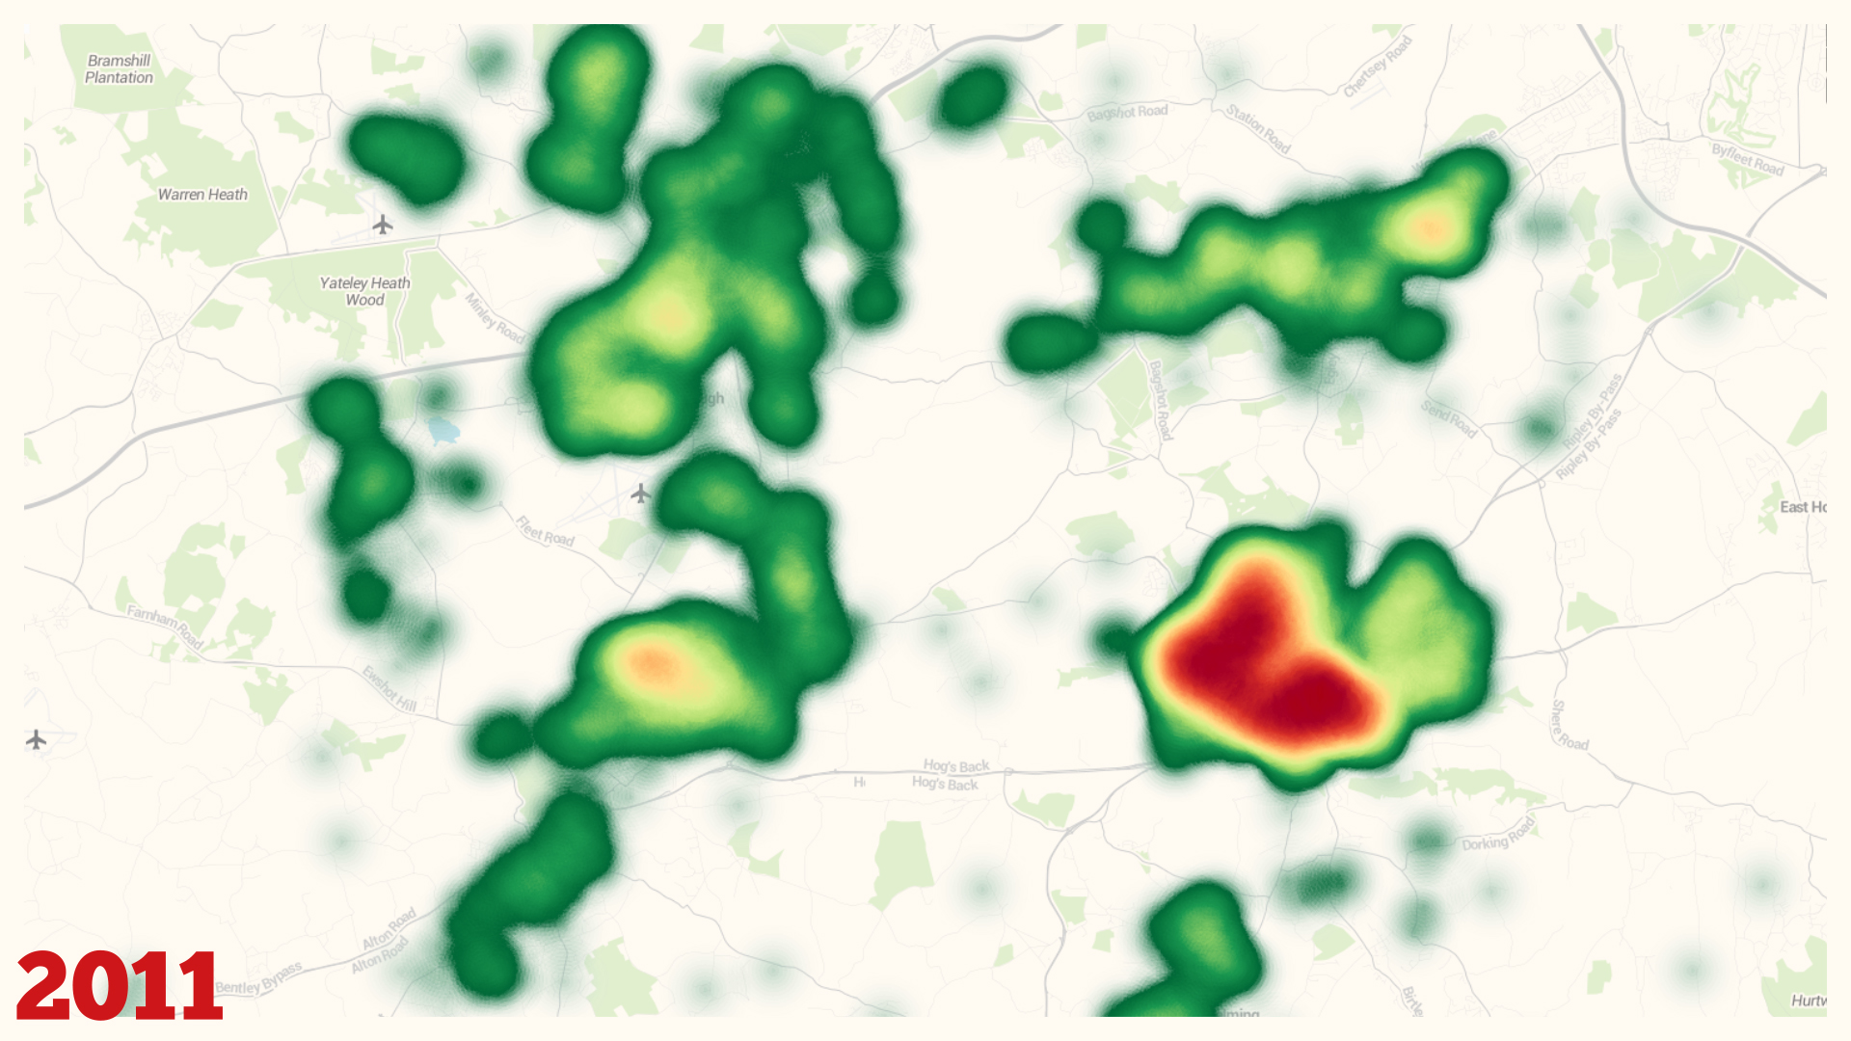
12,540 FT Students

Slide 4
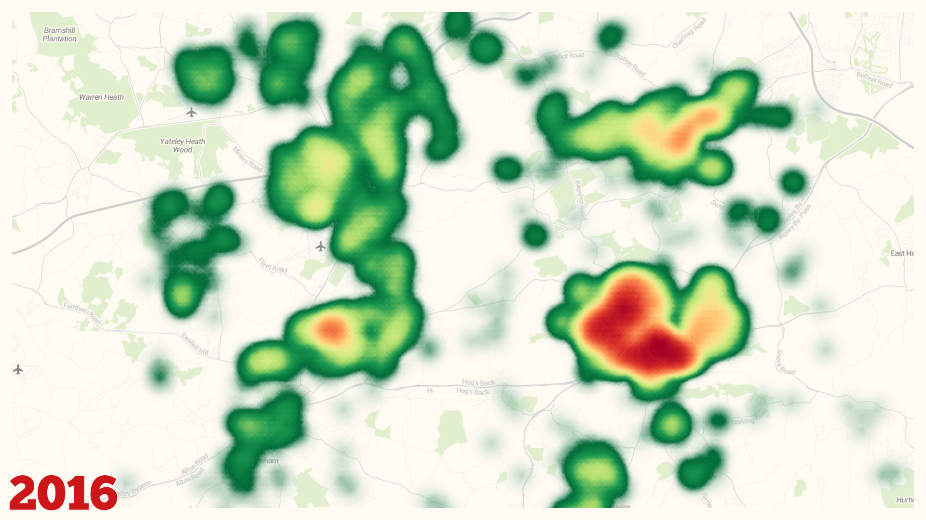
13,271 FT Students

Slide 5
How much do they pay?

Slide 8
Where does the shortfall come from?

